Slide 1
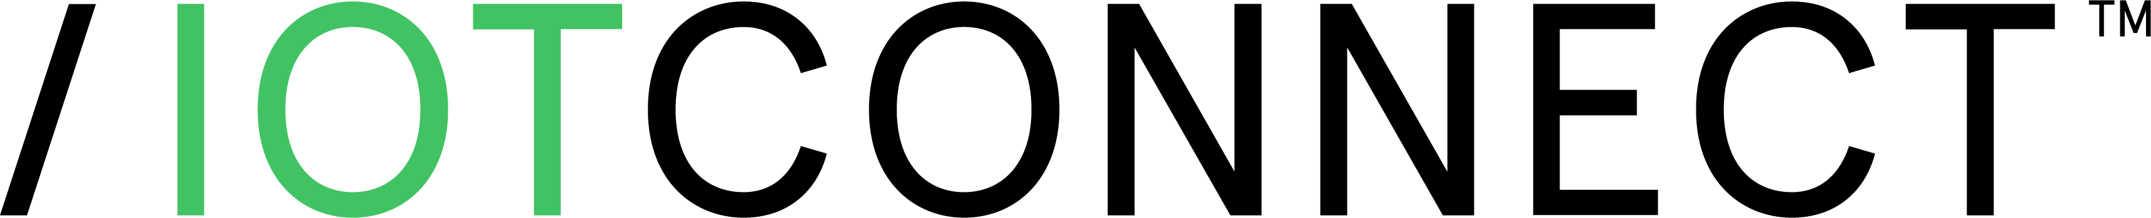


Avnet /IOTCONNECT Solutions Suite
/IOTCONNECT Security CRA Compliance Solution
Manage | Secure | Deploy

Slide 2

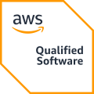
Solution Accelerator & Marketplace Index
SaaS offering
/IOTCONNECT enabled solutions
Smart Generator Monitoring
Smart Warehouse Monitoring
IOTCONNECT Security & Multi-Cloud Data Protection
Avnet's /IOTCONNECT Security & Multi-Cloud Data Protection solution helps organizations secure connected devices, applications, and data across cloud environments through a unified security framework. Leveraging enterprise-grade security controls, data governance, compliance monitoring, identity management, and threat protection capabilities, the solution provides end-to-end visibility and protection for IoT and cloud workloads. Designed for organizations operating across AWS and multi-cloud environments, it helps simplify compliance, reduce security risks, and strengthen data protection while accelerating digital transformation initiatives.
Smart City Noise Detection
AWS IoT Greengrass
Smart Asset Monitoring
AWS Physical AI
Smart Facility Solutions
STM32 Amazon Sidewalk
Smart Factory Solutions
Security CRA
Smart Fleet Management

Slide 3
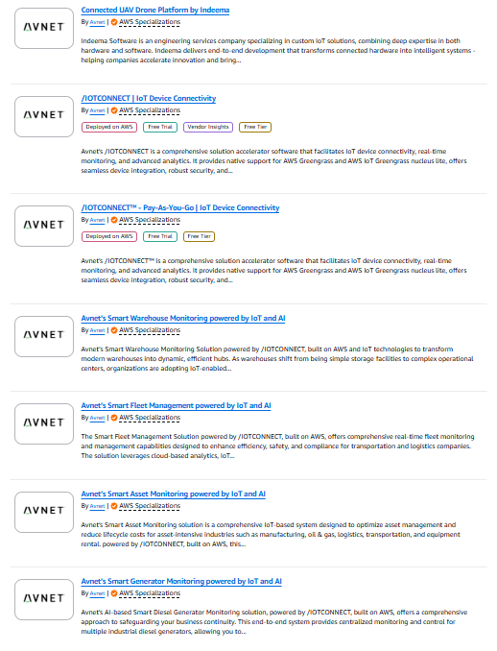
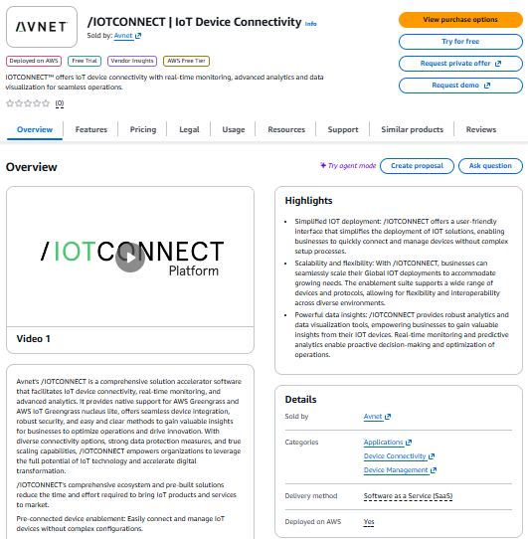
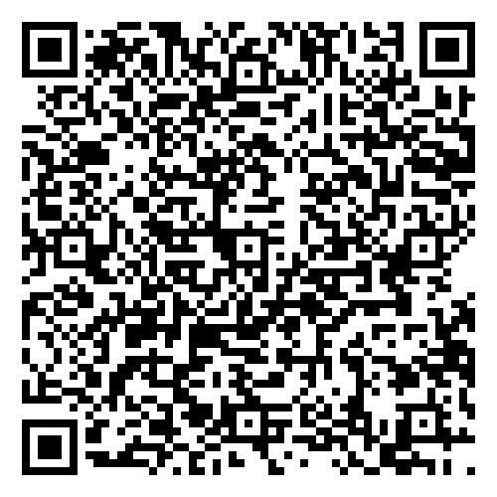
Visit Our Marketplace Listings
All Avnet Listings

Slide 4
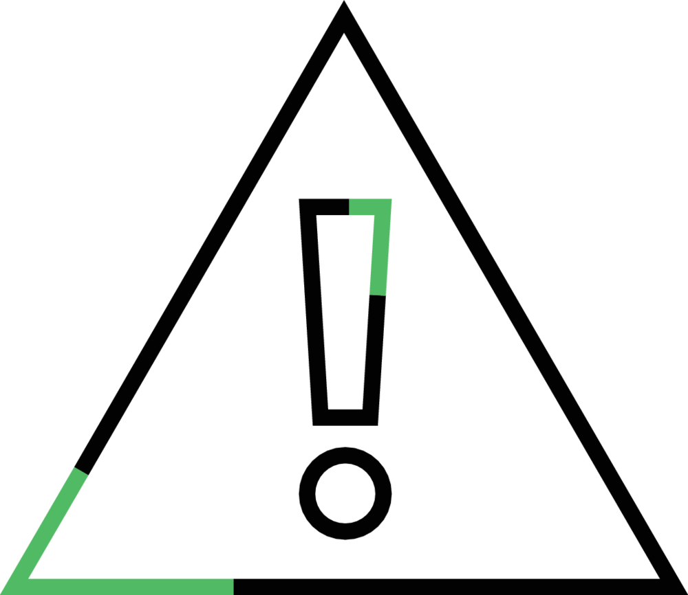

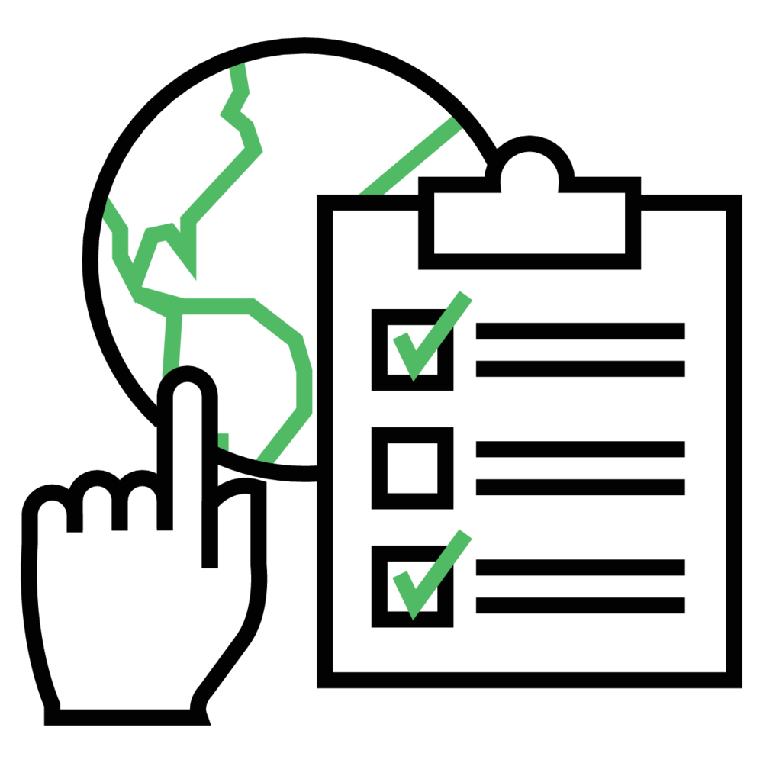


Security CRA
Avnet's /IOTCONNECT Security & Multi-Cloud Data Protection solution helps organizations protect sensitive data across AWS and multi-cloud environments through unified security controls, automated governance, compliance monitoring, and centralized visibility. By combining data discovery, access management, threat protection, and policy enforcement, organizations can reduce security risks, simplify compliance, and confidently scale their cloud and IoT initiatives.
Unified Data Discovery & Protection: Identify and protect sensitive data across cloud environments.
Features
The /IOTCONNECT Security & Multi-Cloud Data Protection solution combines data protection, compliance automation, Zero Trust security, and centralized visibility to help organizations secure sensitive information, reduce risk, and simplify security management across AWS and multi-cloud environments.
Automated Compliance & Governance: Continuously monitor and enforce compliance requirements.
Zero Trust Access Control: Secure access with identity-based authentication and authorization.
Centralized Security Visibility: Monitor risks and security posture from a single view.
Learn more
Marketplace Listing

Slide 5
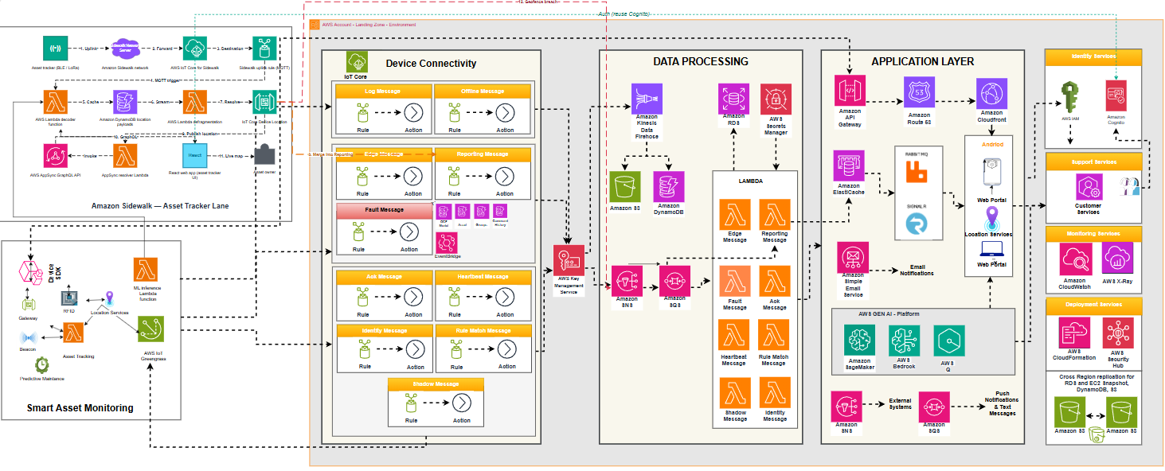
Solution Architecture – Security CRA

Slide 6
Summary & Next Steps
Reduced Compliance Complexity: Streamlines security and regulatory management across multi-cloud environments with centralized controls and automated governance.
Stronger Data Protection: Safeguards sensitive information through continuous monitoring, risk detection, and policy-driven security controls.
Improved Operational Efficiency: Eliminates manual security processes by automating data classification, compliance activities, and access management.
Benefits
Benefits
Faster Audit Readiness: Spend less time preparing for audits and demonstrating compliance with industry regulations.
Lower Security Risk: Reduce the likelihood of data breaches, unauthorized access, and compliance violations.
More Time for Innovation: Free security and IT teams to focus on strategic initiatives instead of routine governance tasks.
Outcomes
Outcomes
Let's Simplify Security, Strengthen Compliance, and Reduce Risk Across Your Cloud Environment
Contact us: IoT@Avnet.com
Next Steps

Slide 7
More About
Avnet /IOTCONNECT & Softweb Solutions (an Avnet company)

Slide 8
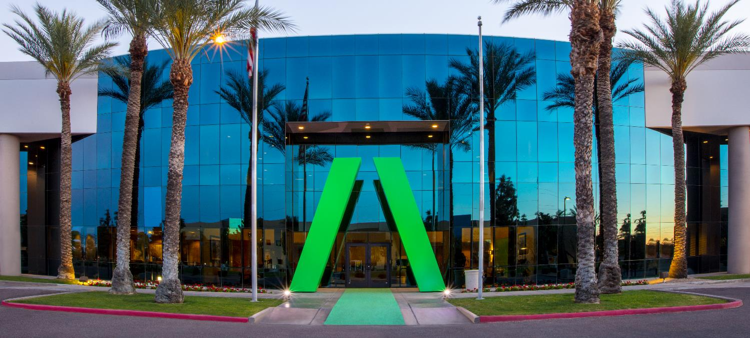
About Avnet
Quick facts
Founded in 1921
Headquartered in Phoenix, Arizona
AVT listed on the NYSE since 1960
AVT listed on NASDAQ since 2018
#181 on FORTUNE 500 (US) in 2025
14,500+
Employees worldwide
2,000+
Engineers around the world
3.3M+
Engineering community members
450K
Customers in
140 countries
250+
Locations
globally
$22.2B
FY25 Revenue
Notes:
As a leading global technology distributor and solutions provider, Avnet has supported customers and suppliers around the world in activating the transformative possibilities of technology.
Avnet is a global company with extensive experience delivering design, supply chain and logistics expertise for customers at every stage of the product lifecycle. We help customers solve challenges anywhere along their product journey, reducing the time, cost and complexities of bringing products to market.
For 100 years, we have continued to expand the breadth and depth of our capabilities through strong supplier relationships, expansion and acquisition. Today, we are headquartered in Phoenix, Arizona, with 14,000+ employees worldwide and 2.1 million customers across the globe.
Our engineers across the globe and 2M+ engineering community members are here to help anyone turn their idea into a product through education, collaboration and high-quality design services.
Then, we’ll help you get that product to market by helping you solve your technology sourcing, manufacturing, supply chain and logistics challenges. We work with customers of every size, in every corner of the world, helping to navigate a simpler path to market.

Slide 9



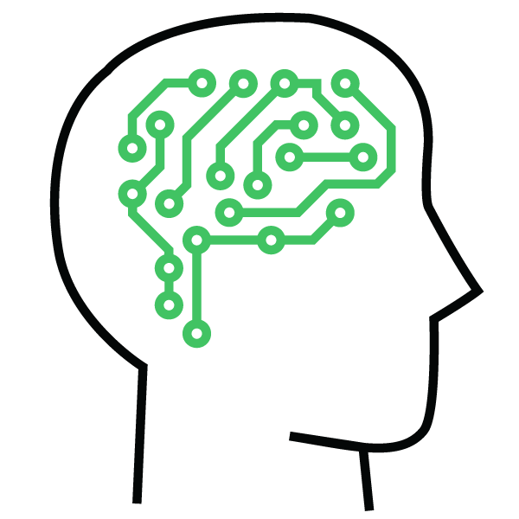


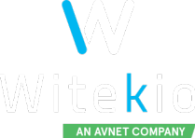






Avnet Capabilities
Cloud Migration | MAP SPRINTS
Migrate data sets and apps to the cloud securely
AWS AI / ML | Gen AI
Rekognition, SageMaker, Bedrock & more
CORE SEMI | Foundational services
IOT PLATFORM FOR OEMS | Foundational services
Mobile Applications
Powerful mobile apps for global audiences
Server Monitoring
Detect cloud computing and network issues
CLOUD APPLICATION DEVELOPMENT
EMBEDDED SOFTWARE
DESIGN SERVICES
Big Data & Analytics
Scalable and secure big data solutions
DESIGNED BY AVNET
Enterprise Applications
Mission-critical apps running on AWS
EMBEDDED MODULES
& BOARDS
SOLUTIONS DEVELOPMENT:
ADVANCED APPLICATIONS GROUP
Managed Services
Infrastructure management on AWS
Notes:
What makes Avnet unique is we can help customer all along their IoT journey weather it is hardware, software, cloud or supply chain support
The items highlight in red are historical 100 year business associated with electronic components
6 years ago we added software and cloud support so that we could offer complete IoT solutions
In the next slide I will show you how we did this.
It is this full IoT offering from the sensors, micros, connective and embedded software at the edge through the cloud application and SI services that is Avnet’s competitive advantage

Slide 10
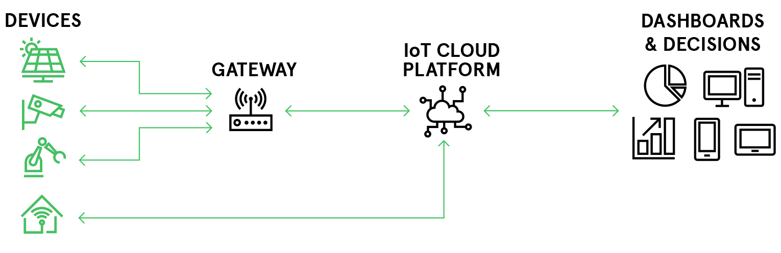
Challenge of IoT
New
Communication Interfaces
Current Generation Product
New IoT Platform
New Hardware Development
Legacy Infrastructure
Mobile App Integration
Developing an IoT product is costly, cumbersome, and time consuming.

Slide 11

Challenge of IoT
With /IOTCONNECT, IoT development becomes simple, secure, and scalable.

Slide 12

Things
Dehumidifiers
In-Wall Moisture Sensors
It takes things like connected dehumidifiers and moisture sensors

Slide 13
Things
Business Insights
Dehumidifiers
extracts
Device Location
In-Wall Moisture Sensors
On-Site Humidity Data
and extracts valuable insights to improve business intelligence

Slide 14
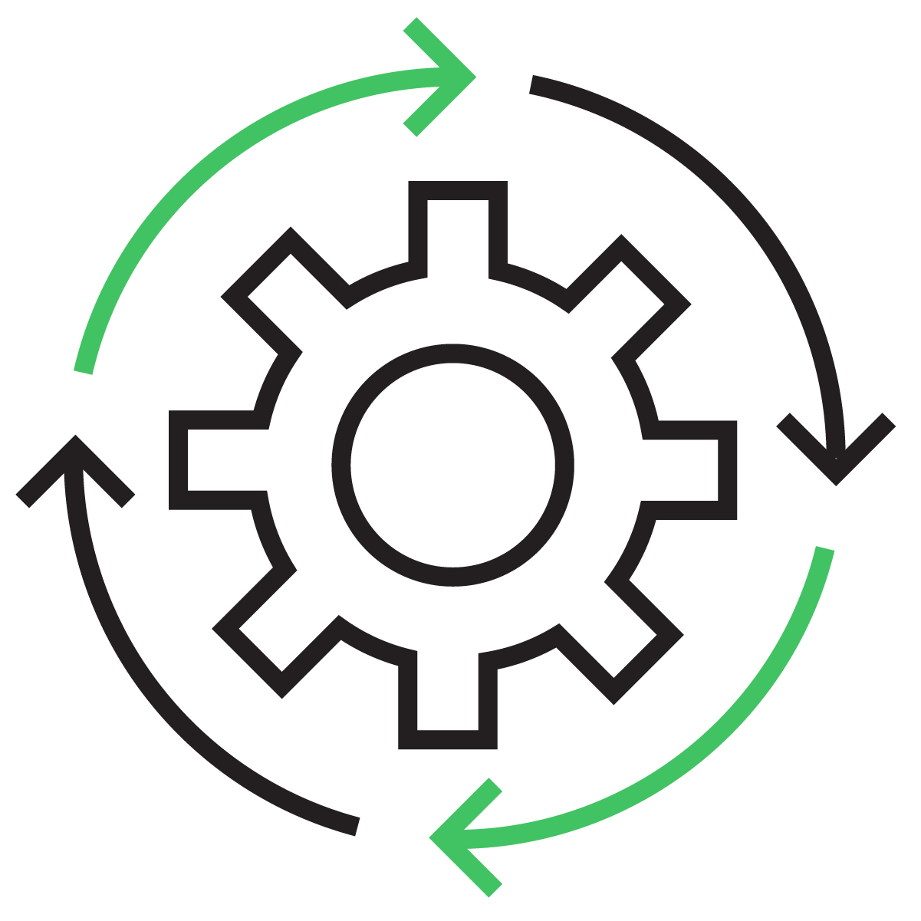



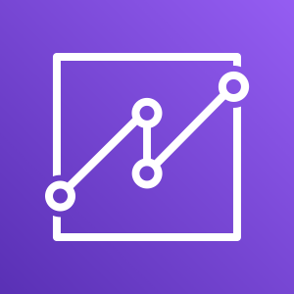

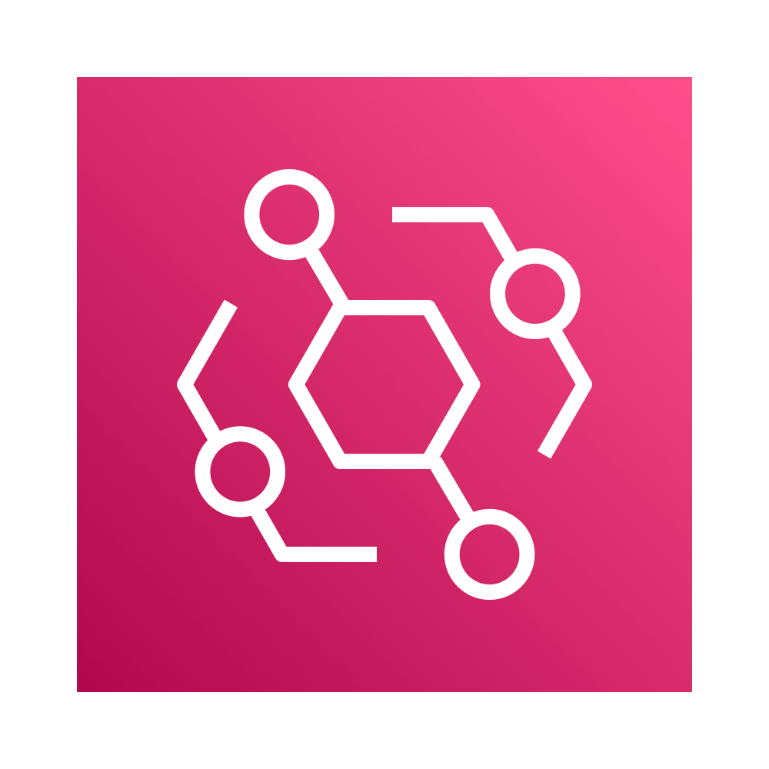
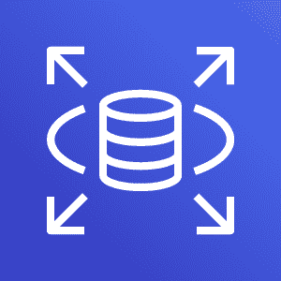
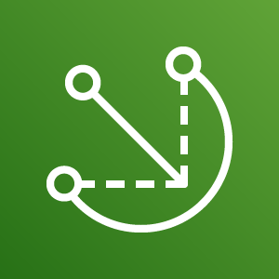
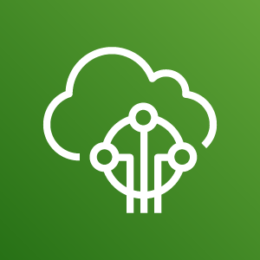
Things
Single Pane of Glass Web Experience
Business Insights
Dehumidifiers
Manage your devices
View and analyze device data
Secure data and devices
Device Location
In-Wall Moisture Sensors
On-Site Humidity Data
Amazon QuickSight
Amazon Simple Storage Service
Amazon EventBridge
Amazon Relational Data Storage
AWS IoT Greengrass
AWS IoT Core
to create a single pane of glass experience
that’s built on AWS

Slide 15



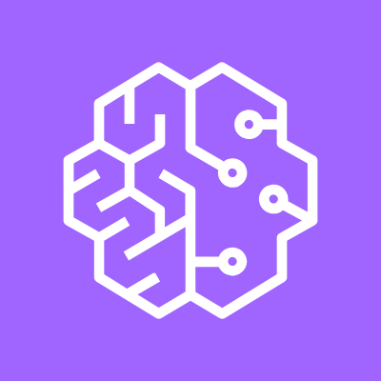

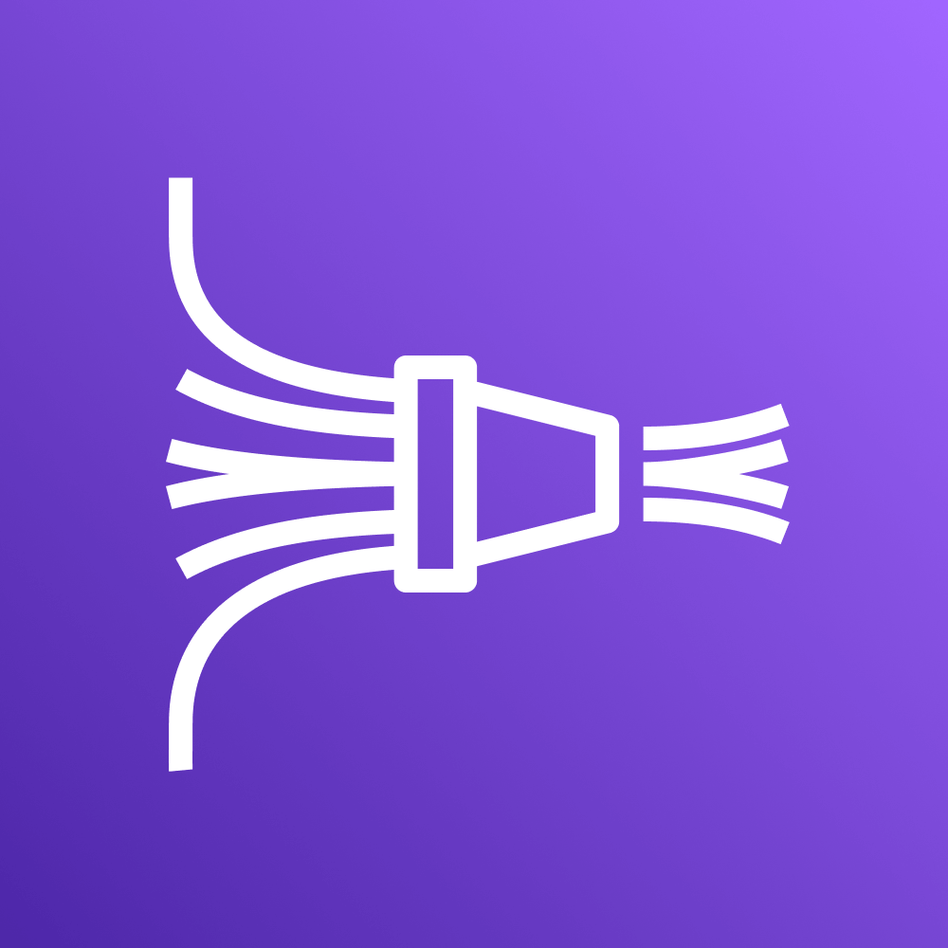


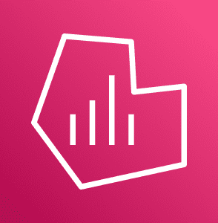
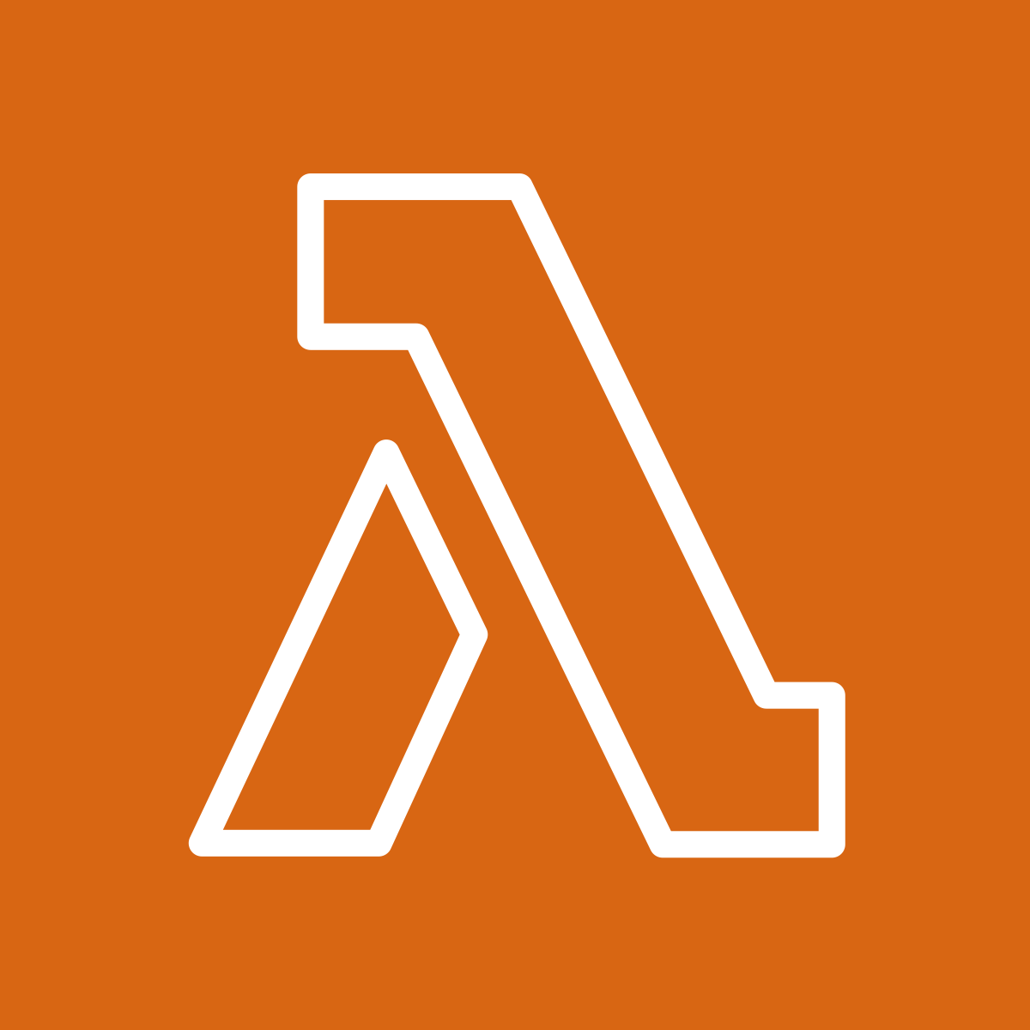

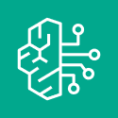
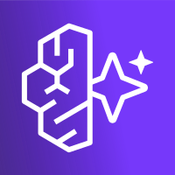


Amazon QuickSight
AWS IoT Core (MQTT, Sidewalk, LoRa WAN)
SaaS IoT Development Platform
Amazon SageMaker
AWS IoT Greengrass
AWS IoT Greengrass
nucleus lite
Amazon Kinesis
Amazon EventBridge
FreeRTOS
Amazon Managed Grafana
AWS Lambda
Amazon DynamoDB
AWS Bedrock
Amazon Relational Data Storage
AWS Bedrock AgentCore
Amazon Simple Storage Service
AWS IoT Device Management: Managed Integrations
Notes:
Here are just a few of the examples of the services that IOTCONNECT has incorporated within its backend. We’ve recently added AWS IoT Device Management: Managed Integrations and AWS IoT Greengrass nucleus lite making connecting smart home devices and edge AI enabled nodes simpler than ever. What all these services come together to make is….

Slide 16

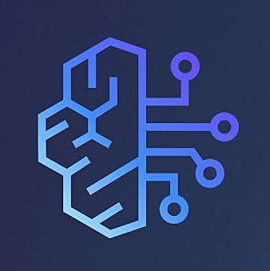
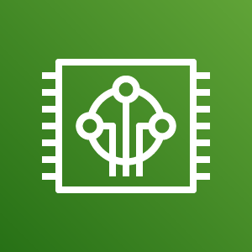
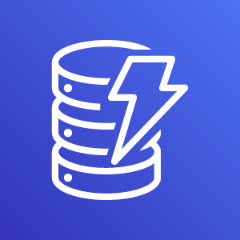
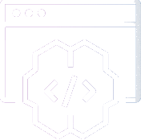
One interface for AWS services
And aggregate them to create one ecosystem for production ready IoT

Slide 17
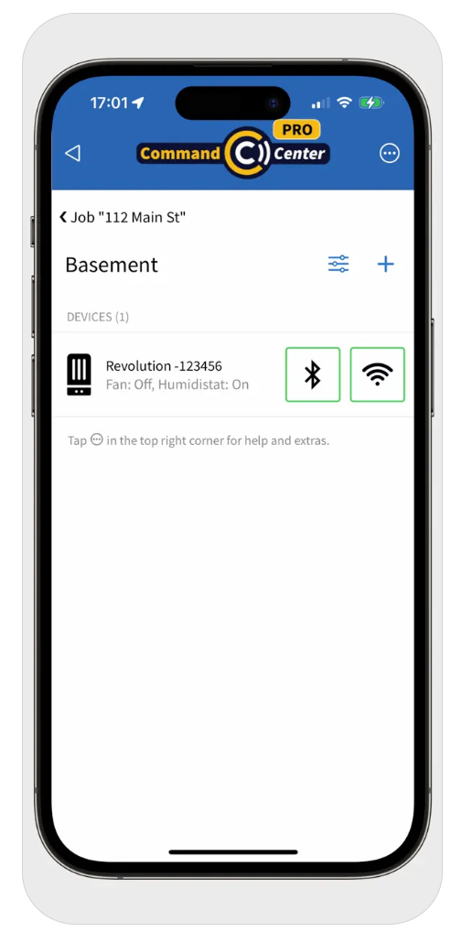
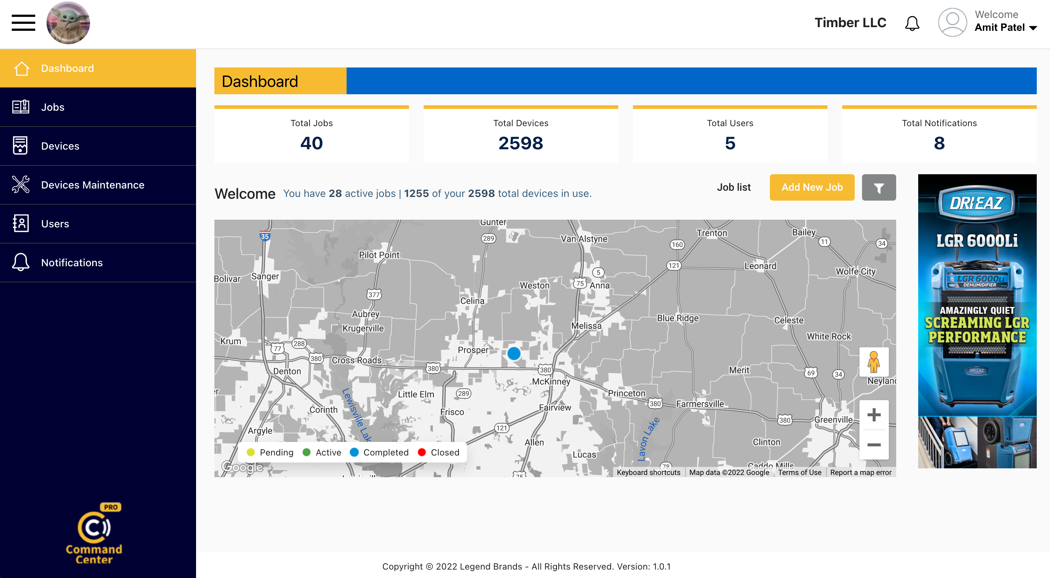
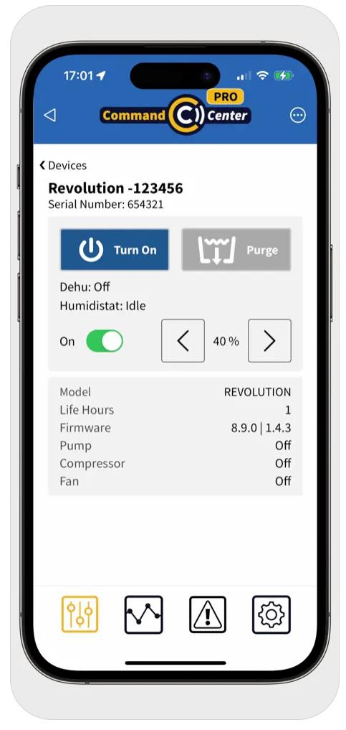
/IOTCONNECT SaaS Application in Action

Slide 18
Next Steps

Slide 19
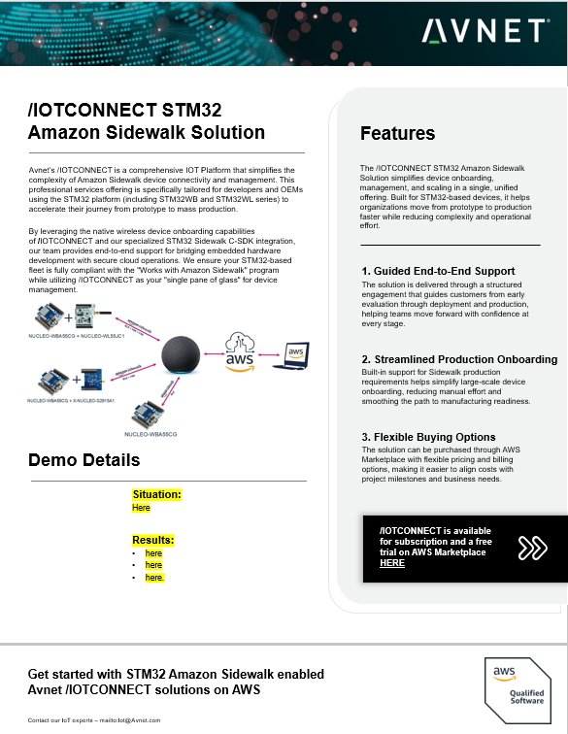
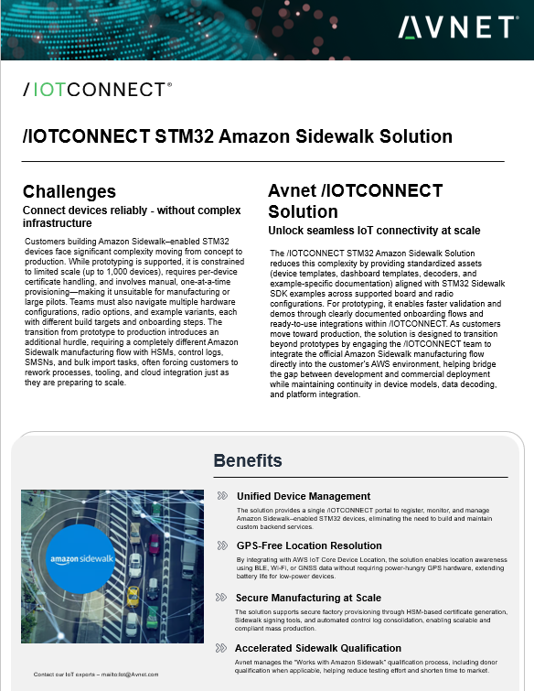
Update image
Contact us!
Learn more

Slide 20
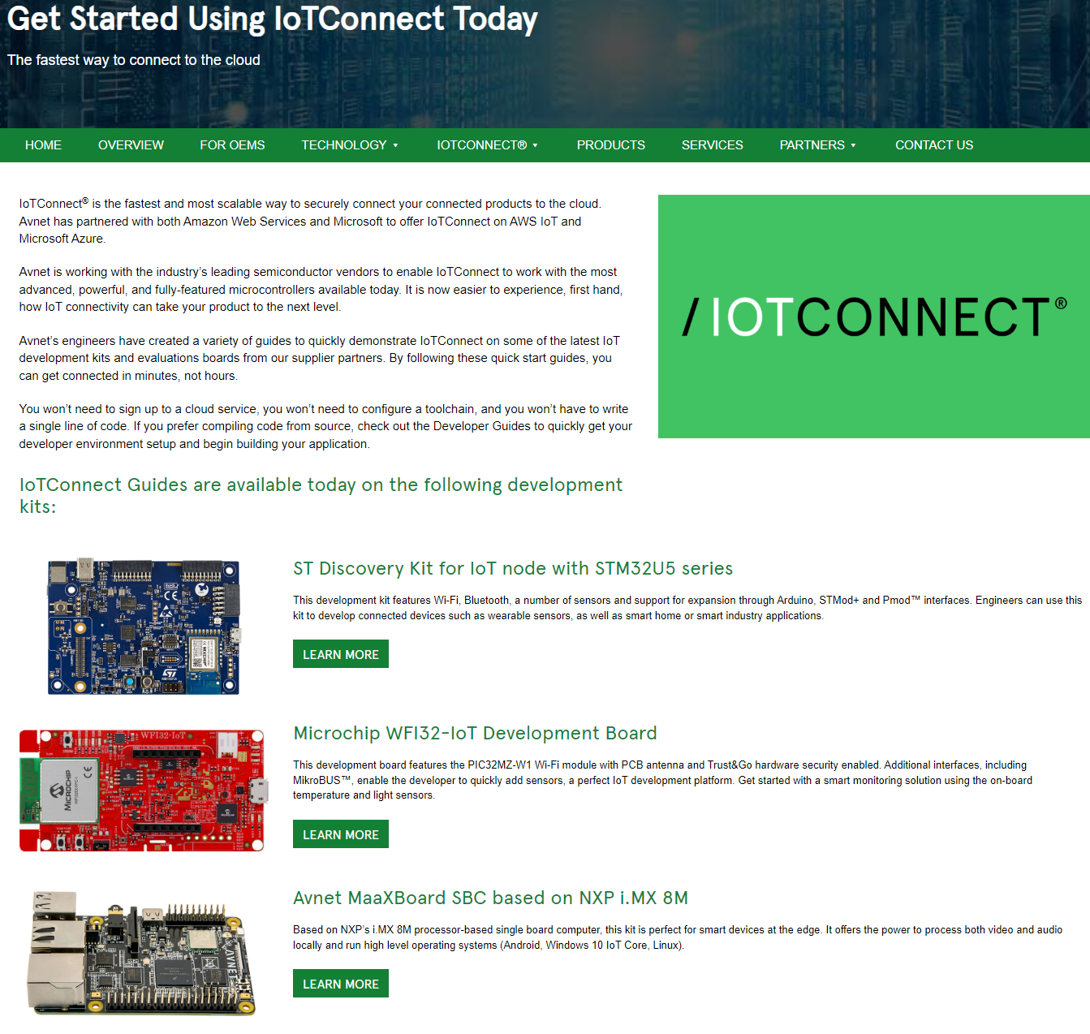
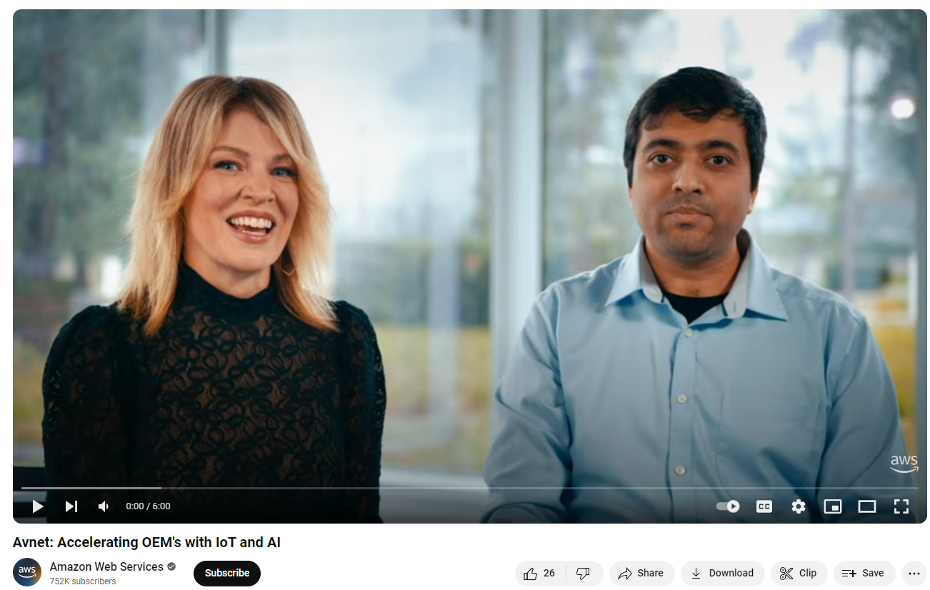
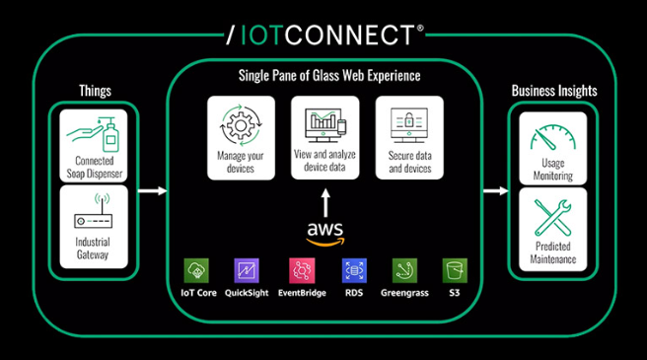
Resources
Avnet and AWS:
This is My Architecture
Avnet
/IOTCONNECT Webinar
/IOTCONNECT Quick Start Development Kits

Slide 21
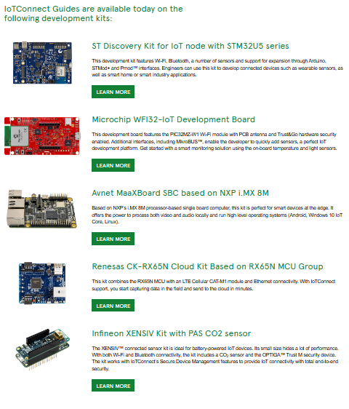
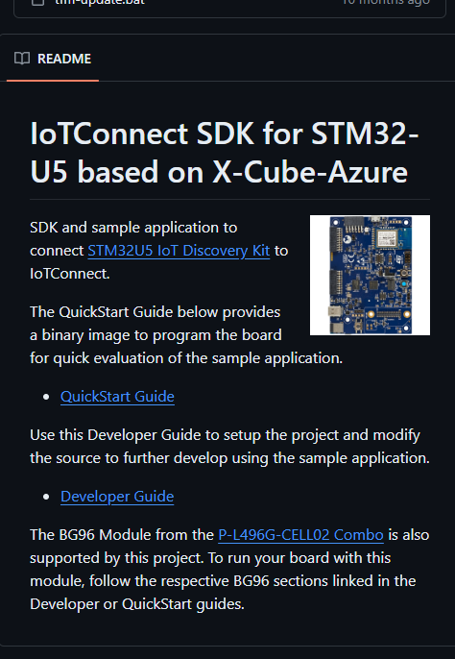
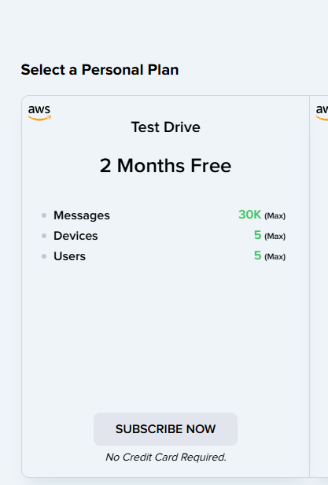
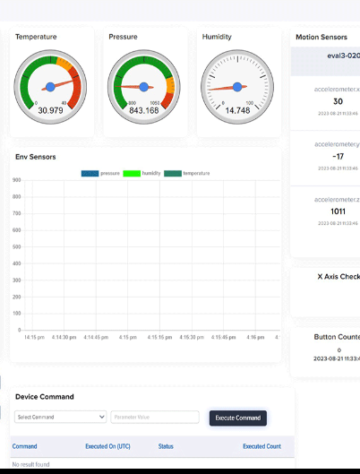
/IOTCONNECT Quick Start Enablement
1
2
3
4
Pick a Board
Access GitHub
Sign up for Free Trial
Start Developing
Access our quick start landing page to look at the variety of developer board options that we have enabled. Select which board fits your need.
Click the GitHub link to see the sample code we have created for each of these developer kits. These include templates and dashboards.
Using the provided link from the quick start guide, sign up for a free /IOTCONNECT account and demo all of the design acceleration features.
With dynamic dashboards and easy onboarding widgets, /IOTCONNECT makes designing for your application simple, secure, and scalable.

Slide 22
Appendix

Slide 23

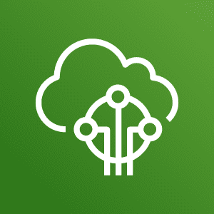


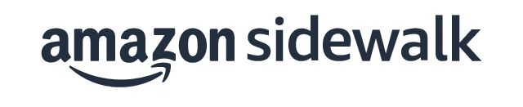
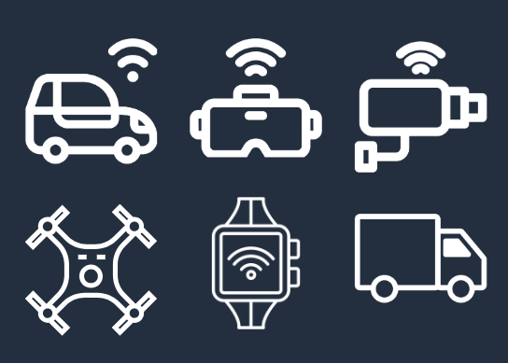
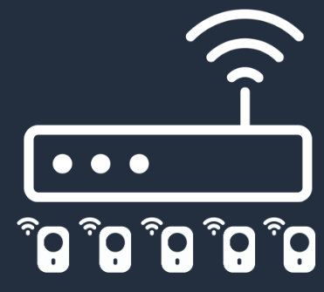
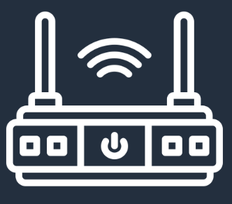


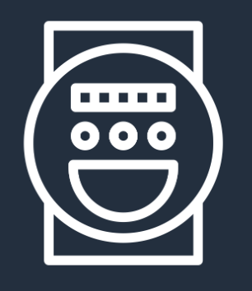
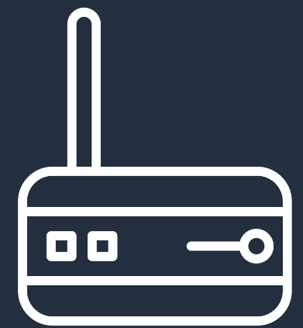
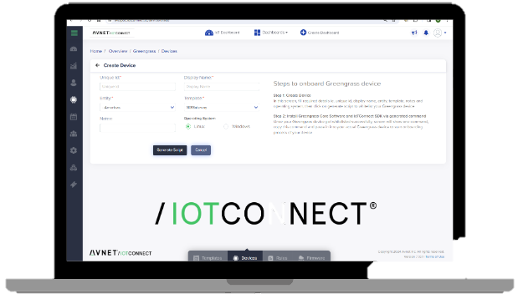


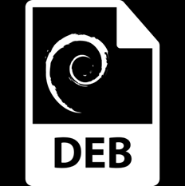
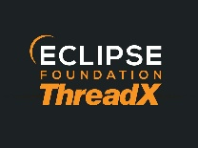








IOTCONNECT™ Supports All Devices
AWS IoT Core for
AWS IoT Greengrass
+ Greengrass lite
AWS IoT Core
Services
Device
Types
Connected Devices
Gateway & Child Devices
Private
LoRaWAN
Base Station
Private
LoRaWAN
Concentrator
Public
LoRaWAN
Device
Amazon
Sidewalk
Device
Edge Server or Gateway
Memory Constrained Edge Device
Device
Enablement
AWS IoT Greengrass
/IOTCONNECT™ enables ALL devices types through a single pane of glass.
Notes:
But we also support every different device type that will be required for your application. Whether it’s a directly connected device, a gateway with child elements, LoRaWAN, Edge servers or even memory constrained devices needing nucleus lite, IOTCONNECT supports the device connection through our wide array of communication protocols and languages. If it can be connected to, IOTCONNECT can connect to it. Additionally with all the enablement work that we’ve built within out GitHub library, we’ve made it simple to get started faster than ever.

Slide 24












/IOTCONNECT Building Blocks w/ AWS
/IOTCONNECT Cloud
IoT Device
/IOTCONNECT SDK
Edge Application
& Analytics
Control Path
Data Path
Biz Application
Visualization
Advanced Analytics & AI
FreeRTOS
Python
Greengrass
IoT Core
RDS
QuickSight
SageMaker
Python
C
EventBridge
S3 Data Lake
Grafana
S3
Kinesis
DynamoDB
Lambda
Notes:
An edge to cloud IOT solution involves a great deal of capability AND complexity. As an OEM, driven to deliver connected products today, the task can be daunting and downright intimidating at every step of the journey. Avnet’s silicon providers are using /IOTCONNECT as an easy onboarding mechanism to AWS services. These universal methods make it easy for our joint customers to move from POC to production. Through our partnership with you, we are upping the probability of our suppliers and OEM customers finally achieving scale w/in the IoT

Slide 25

/IOTCONNECT Platform Architecture
Notes:
DIRECT NOTES FROM AWS:
“The platform takes an opinionated approach to the system design with the use of platform specific MQTT topics that saves the customers from doing MQTT topic design. These topics make use of basic ingest to provide cost optimized device to platform interaction. And because each member account on the platform aligns with an AWS account “under the hood”, isolation between customer fleets and access are isolated along AWS account boundaries. This not only removes the need from maintaining isolation at the MQTT broker or IoT Core level, it also reduces the blast radius by ensuring that the usage of one customer cannot affect others on the platform.
Moving up the stack, you will see various Lambda function that are used for managing rules, reporting and persisting data… finally terminating in the application gateway section that enables the consumption and management of fleet data. This interface ultimately enables solution acceleration
Overall, you will see how by leveraging best practices the Avnet and Softweb teams were able to implement an IoT platform that helps customers accelerate their IoT journey. ”

Slide 26








/IOTCONNECT Developer Personas
Device, User, Roles, and Entity Admin
Security manag
Basic dashboarding
Internal Ops
RESTful API
Predictable URLs
Intelligent error handling
OAuth 2.0 authentication
Access to all IoTC functions
Dynamo DB, S3
Signal R
MQTT
Grafana
AWS SNS
Notes:
Users or Developer Pers

Slide 27









/IOTCONNECT SDKs: Deliver a Positive Developer Experience
Objectives:
Deliver device-builders a positive developer-experience
Integrate into the Avnet Supplier's development flow and ecosystem
Provide confidence for a successful outcome at the onset of our customer’s IoT journey
Software Resources
/IOTCONNECT Enablement, Witekio, and Softweb service teams
Access to global and scalable Avnet software services
Skills: C, Python, Java, OS/RTOS, Applications, AI/ML
Deliverables
/IOTCONNECT Library
SDK (C / C# / Python / …)
Test Strategy
Platform Targeted Samples
Developer Guide
QuickStart Experience

Slide 28





















Device Enablement: SDKs
Generic SDKs
Multiple Languages and Environments
Platform-specific SDKs
Development Boards and Embedded Hardware
https://docs.iotconnect.io/iotconnect/sdk/
https://github.com/avnet-iotconnect/
Notes:
Open Links

Slide 29



/IOTCONNECT AWS Demo Examples
AI/ML Audio Classification
Edge ML Voice and Motion Detection
Consumer Indoor Grill

